Slide 1

PROJECT REPORT OF SUMMER
INTERSHIP
TOPIC:-
PROFESSIONAL
Submitted to:- Shashwat Singhal
Submitted by:-Unnati Chaurasia

Slide 2
INTRODUCTION
A professional is an individual who has the required education, knowledge, skills, and experience to perform a specific job or occupation efficiently. A professional follows ethical standards, acts responsibly, and maintains a high level of competence in their work. Professionalism involves honesty, discipline, accountability, respect, and continuous learning. Professionals play a vital role in the growth of organizations and society by providing quality services and making informed decisions. Examples include but not limited to doctors, teachers, engineers, lawyers, accountants, and managers.

Slide 3
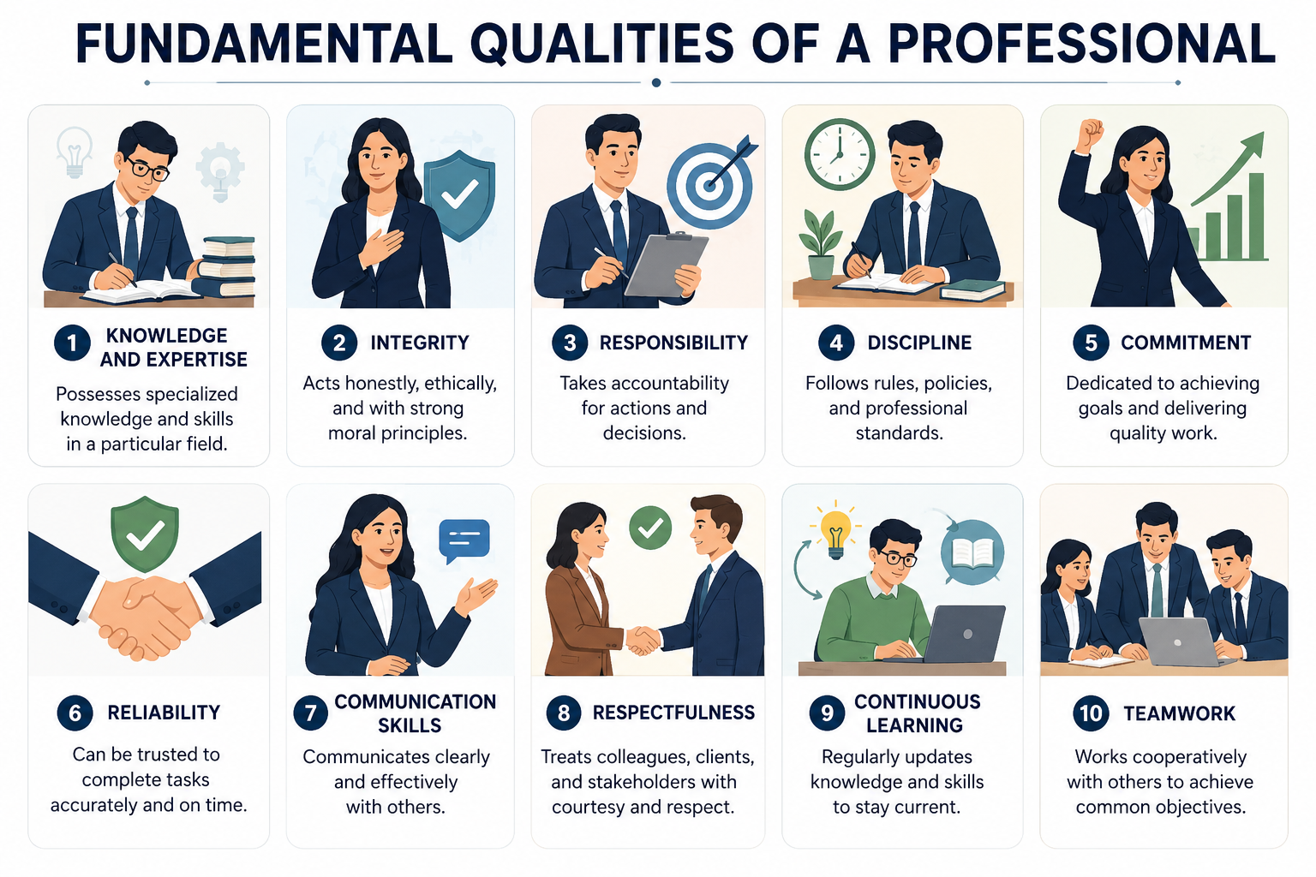
Fundamental Qualities of a Professional
Knowledge and Expertise
Integrity
Responsibility
Discipline
Commitment
Reliability
Communication Skills
Respectfulness
Continuous Learning

Slide 4

Professional Communication
Clear and effective verbal communication.
Proper written communication.
Active listening skills.
Respectful interaction with others.
Professional use of emails and digital platforms.

Slide 5
Skills Required for Professionals
Communication skills
Leadership skills
Problem-solving skills
Time management
Teamwork and collaboration
Continuous learning
Code of conduct

Slide 6
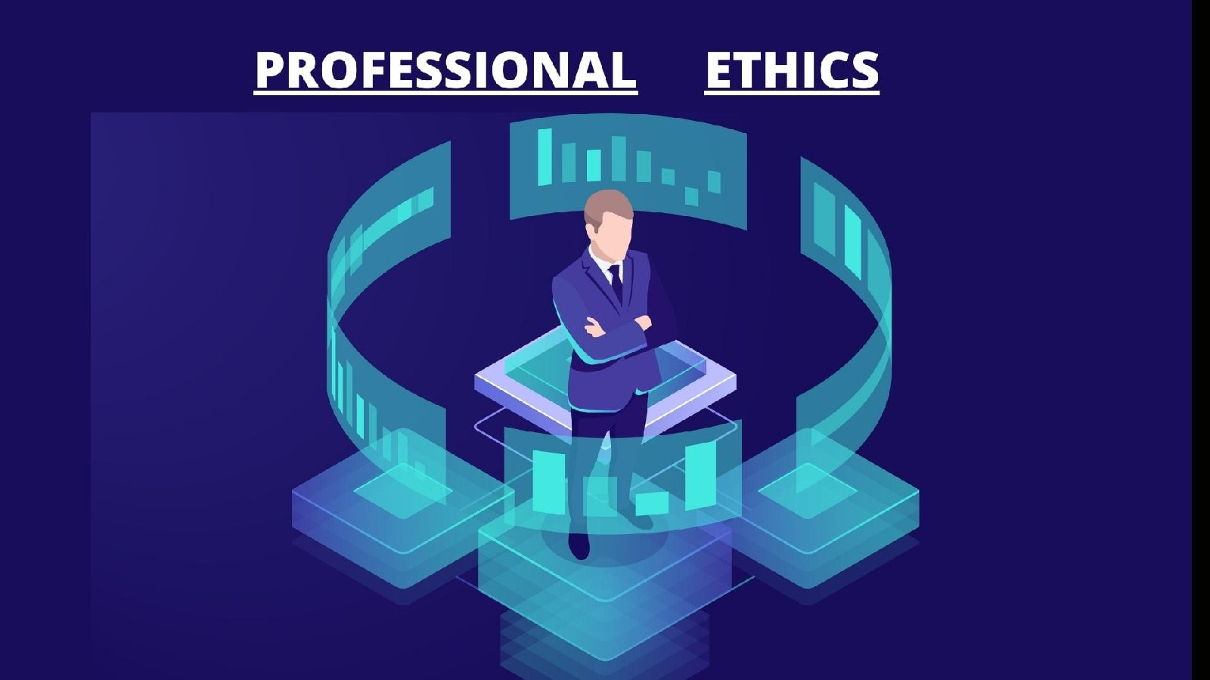
Professional Ethics
Maintain honesty and transparency.
Respect confidentiality.
Follow laws and regulations.
Treat everyone fairly and respectfully.

Slide 7

Future of Professionalism
Increased use of technology and AI.
Greater emphasis on soft skills.
Lifelong learning and upskilling.
Global collaboration and remote work.
Strong focus on ethics and sustainability.

Slide 8
Challenges Faced by Professionals
Managing work pressure and deadlines.
Adapting to technological changes.
Maintaining work-life balance.
Handling ethical dilemmas.
Continuous skill development.

Slide 9
Conclusion
Professionalism is a combination of knowledge, skills, ethics, responsibility, and positive behaviour. A professional demonstrates integrity, discipline, commitment, and continuous learning while performing their duties. Professionalism helps build trust, improve workplace efficiency, and achieve career success. In today's dynamic world, professionals must adapt to new technologies, maintain ethical standards, and develop both technical and interpersonal skills. Overall, professionalism is essential for personal growth, organizational success, and the development of society.

